Slide 1





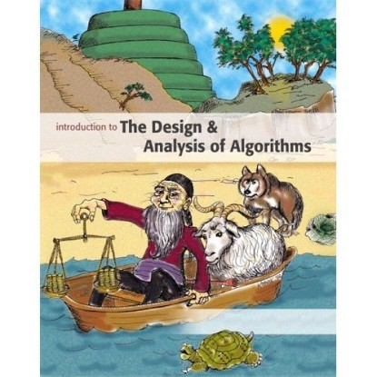
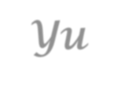


Introduction to
Algorithm Design and Analysis
[15] Path in Graph
Yu Huang
http://cs.nju.edu.cn/yuhuang Institute of Computer Software Nanjing University

Slide 2

In the last class…
Optimization Problem
Greedy strategy
MST Problem
Prim’s Algorithm
Kruskal’s Algorithm
Single-Source Shortest Path Problem
Dijstra’s Algorithm
2

Slide 3

Path in Graphs
Single-source shortest path
Dijkstra’s algorithm by example
Priority queue-based implemetation
Proof of correctness
All-pair shortest path
Shortest Path and Transitive Closure
Washall’s Algorithm for Transitive Closure
All-Pair Shortest Paths
Matrix for Transitive Closure
Multiplying Bit Matrices - Kronrod’s Algorithm
2

Slide 4
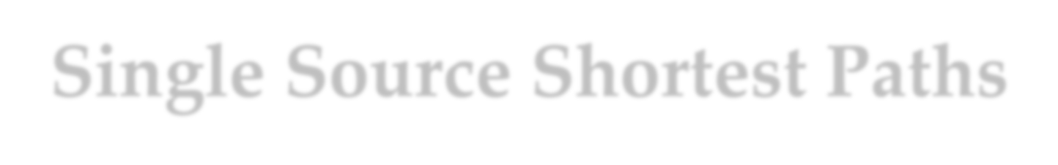
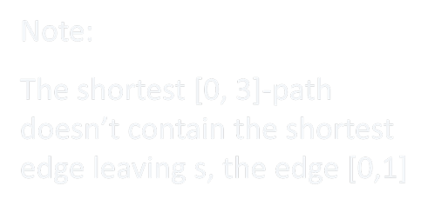







Single Source Shortest Paths
The single source
Red labels on each vertex is the length of the shortest path from s to the vertex.
Note:
The shortest [0, 3]-path doesn’t contain the shortest edge leaving s, the edge [0,1]
1 2
2
7
5
3
1
1 2
8
7
6
3
6
s ₀
2 4
3
4
3
4
6
4
5
9
2

Slide 5


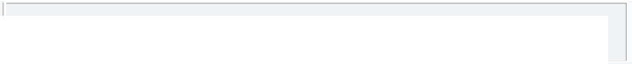
Warm Up
Single-source shortest path over uniformly weighted graph
o Just BFS
Breadth-first Search
Starting node
A
D
B
G
F C E
Not reachable
2

Slide 6


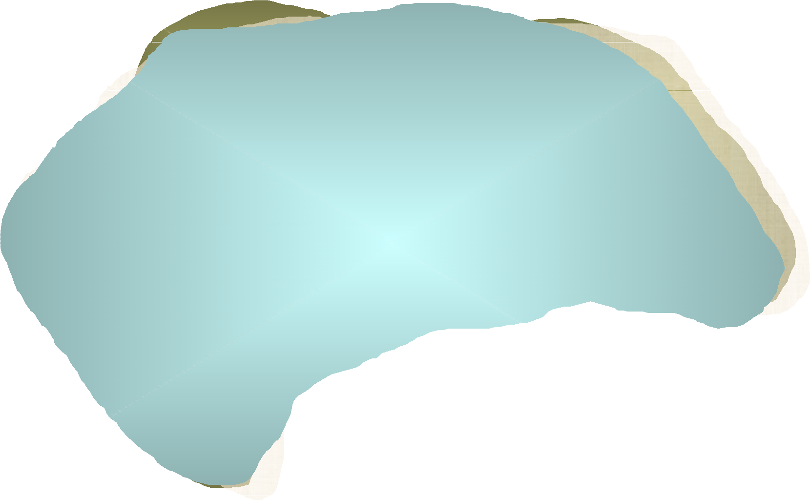
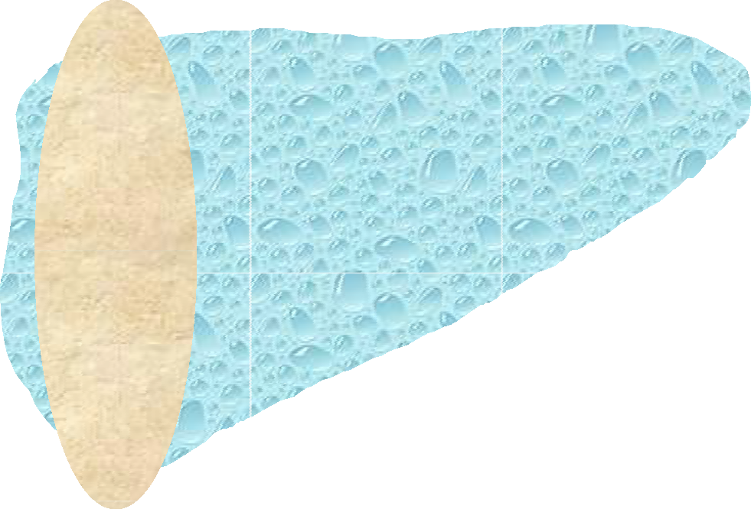
Dijkstra’s Algorithm
1∞ 2
∞₂
7
1
3
5
1
2
∞₆8
8
s
0
7
3
4∞3
∞76
4
3
4
2
4
6
∞4
5
∞9
2

Slide 7


Priority Queue-based Implementation
Shortest Paths
Void shortestPaths(EdgeList[] adjInfo, int n, int s, int[] parent, float[]fringeWgt)
int[] status = new int[n+1];
MinPQ pq = create(n, status, parent, fringeWgt);
insert(pq, s, -1, 0); while(isEmpty(pq)==false)
int v = getMin(pq); deleteMin(pq); updateFringe(pq, adjInfo[v], v);
void updateFringe(MinPQ pq, EdgeList adjInfoOfV, int v)
float myDist = pq.fringeWgt[v]; EdgeList remAdj;
remAdj = adjInfoOfV; while{remAdj != nil}
EdgeInfo wInfo = first(remAdj); int w = wInfo.to;
float newDist = myDist + wInfo.weight; if(pq.status[w]==unseen)
insert(pq,w,v,newDist); else if(pq.status[w] = fringe)
if(newDist < getPriority(pq,w)) decreaseKey(pq,w,v,newDist);
remAdj = rest(remAdj); return;
2015/5/19
Lecturea on Algorithm Design & Analysis (LADA), 2015
7

Slide 8


















Correctness of
the Dijkstra’s Algorithm
W(s->y->z) < W(s->z_{a-1}->z_{a}->z)
Z_{a}
d(s,z_{a-1})
^{Z}a-1
S
d(s,y)
y
z

Slide 9




From Algorithm to Skeleton
Single-source shortest path (SSSP)
SSSP + node weight constraint
E.g. in routing
Each router has a cost (node cost)
“Dijkstra’s Skeleton”
Each route has a cost (edge cost)
SSSP + capacity constraint
The “pipe problem”
The “PEV problem”
Pure Electric Vehicle

Slide 10

Fundamental Questions
For all pair of vertices in a graph, say, u, v:
Is there a path from u to v?
What is the shortest path from u to v?
Reachability as a (reflexive) transitive closure of the adjacency relation
o which can be represented as a bit matrix

Slide 11






Transitive Closure by Shortcuts
The idea: if there are edges s_{i}s_{k}, s_{k}s_{j}, then an edge s_{i}s_{j}, the “shortcut” is inserted.
1
2
1
2
1
2
5
3
5
3
5
3
4
4
4
Pass one
Pass two
Note: the triple (1,5,3) is considered more than once

Slide 12


Shortcut Algorithm
Input: A, an n×n boolean matrix that represents a binary relation
Output: R, the boolean matrix for the transitive closure of A
Procedure
o void simpleTransitiveClosure(boolean[ ][ ] A, int n, boolean[ ][ ]
R)
int i,j,k;
Copy A to R;
Set all main diagonal entries, r_{ii}, to true;
while (any entry of R changed during one complete pass)
o o o o
O(n⁴)
for (i=1; i≤n; i++)
for (j=1; j≤n; j++)
for (k=1; k≤n; k++)
r_{ij}=r_{ij}∨(r_{ik}∧r_{kj})
The order of (i,j,k) matters

Slide 13









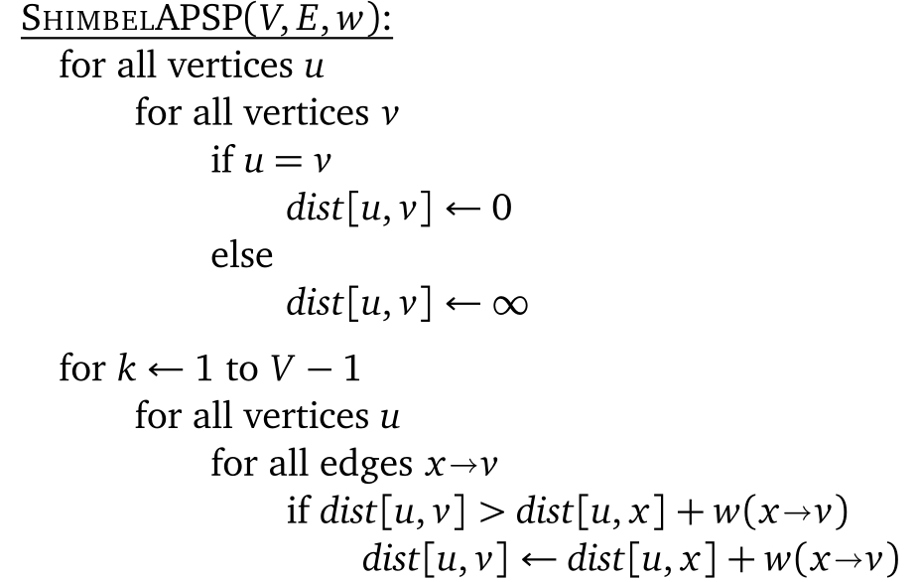






Another Way to Add Shortcuts
for every u
u
O(n²m)
x v
for each edge xv
n-1 round iteration

Slide 14




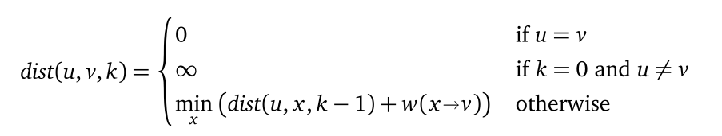

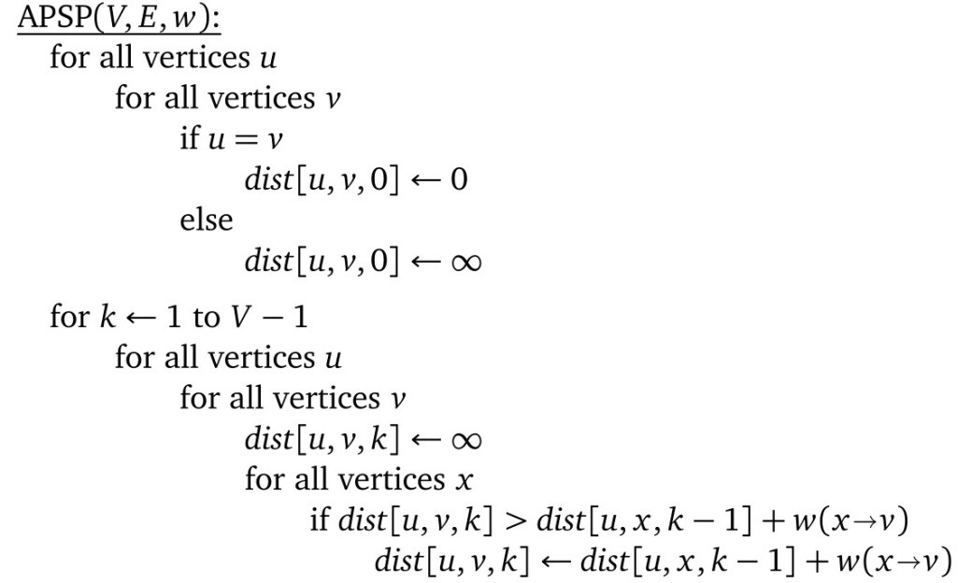


Length of the Path
Length of the shortest path of at most k edges
for every u
O(n⁴)
u
k path
k-1 path
1 path
x
v
for every x
for every v

Slide 15



Shortcuts in Different Order
Duplicated checking may be deleted by changing the order of the vertices.
1
2
1
2
5
3
5
3
4
No edge is added in Pass two. End.
4
Pass one
Check the vertices in decreasing order.

Slide 16

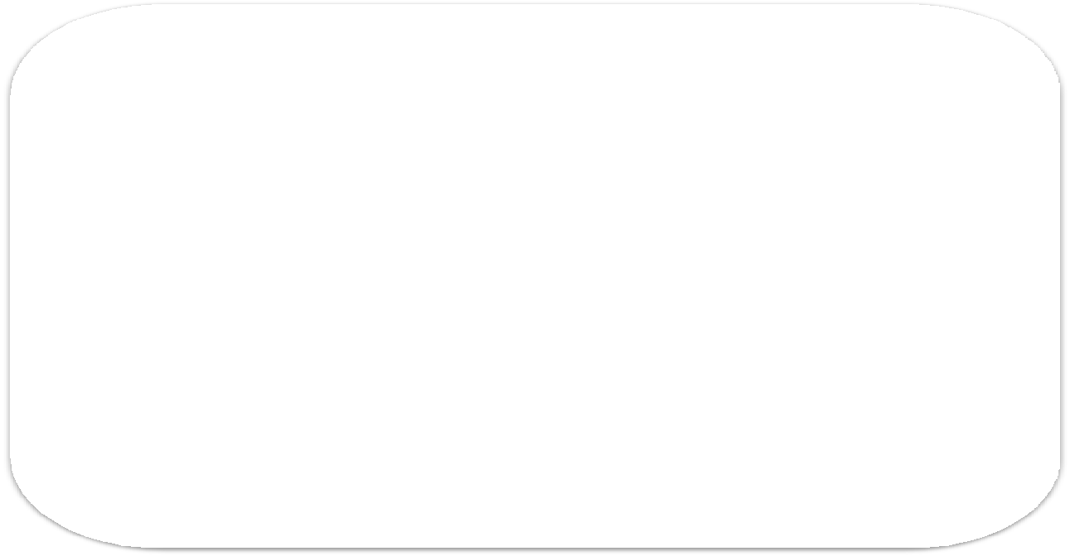


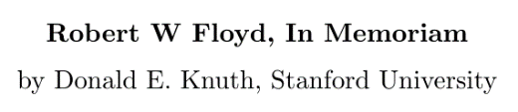

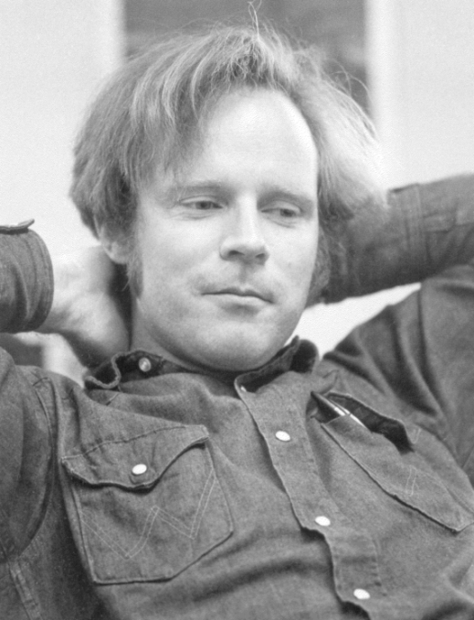

Floyd’s Lemma
组合问题的优良算法具有巨大回报，这个 事实激励了技术水平的突飞猛进。… … 大 约从1970年起，计算机科学家们经历了所 谓的‘Floyd引理’现象：看似需用n³次运 算的问题实际上可能用O(n²)次运算就能求 解，看似需用n²次运算的问题实际上可能 用O(nlogn)次运算就能处理，而且nlogn通 常还可以减少到O(n)。一些更难的问题的 运行时间也从O(2^{n})减少到O(1.5^{n})，再减少 到O(1.3^{n})，等等。
- Knuth, Volumn4A, TAOCP

Slide 17

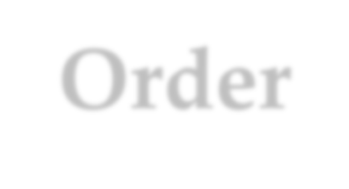

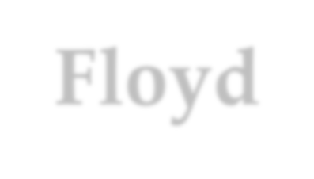







Change the Order: Floyd-Warshall’s Algorithm
o void simpleTransitiveClosure(boolean[][] A, int n,
boolean[][] R)
int i,j,k;
Copy A to R;
Set all main diagonal entries, r_{ii}, to true;
while (any entry of R changed during one complete pass)
o o o o
k varys in the outmost loop
for (k=1; k≤n; k++)
for (i=1; i≤n; i++)
for (j=1; j≤n; j++)
r_{ij}=r_{ij}∨(r_{ik}∧r_{kj})
Note: “false to true” can not be reversed

Slide 18



Correctness of Warshall’s Algorithm
Notation:
The value of r_{ij} changes during the execution of the body of the “for k…” loop
After initializations: r_{ij}
(0)
After the k^{th} time of execution: r_{ij}
(k)

Slide 19


Correctness of Washall’s Algorithm
If there is a simple path from s_{i} to s_{j}(i≠j) for which the highest-numbered intermediate vertex is s_{k}, then
r ^{(k)}=true. ij
Proof by induction:
Base case: r_{ij}⁽⁰⁾=true if and only if s_{i}s_{j}∈E
Hypothesis: the conclusion holds for h<k(h≥0)
Induction: the simple s_{i}s_{j}-path can be looked as s_{i}s_{k}-path+s_{k}s_{j}-path, with the indices h₁, h₂ of the highest-numbered intermediate vertices of both segment strictly(simple path) less than k. So, r_{ik}^{(h1)}=true, r_{kj}^{(h2)}=true, then r_{ik}^{(k-1)}=true, r_{kj}^{(k-1)}=true(Remember, false to true can not be reversed). So, r_{ij}^{(k)}=true

Slide 20





Highest-numbered Intermediate Vertex
The highest intermediate vertex in the intervals (s_{i}s_{k}), (s_{k}s_{j}) are both less than s_{k}
s_{j}
s_{k}
s_{i}
A specific order is assumed for all vertices
Vertical position of vertices reflect their vertex numbers
r_{ij}=r_{ij}∨(r_{ik}∧r_{kj})

Slide 21
Correctness of Washall’s Algorithm
If there is no path from s_{i} to s_{j}, then r_{ij}=false.
Proof
If r_{ij}=true, then only two cases:
r_{ij} is set by initialization, then s_{i}s_{j}∈E
Otherwise, r_{ij} is set during the k^{th} execution of (for
k=1,2,…) when r_{ik}^{(k-1)}=true, r ^{(k-1)}=true, which, recursively,
kj
leading to the conclusion of the existence of a s_{i}s_{j}-path. (Note: If a s_{i}s_{j}-path exists, there exists a simple s_{i}s_{j}-path)

Slide 22



All-pairs Shortest Path
Shortest path property
o If a shortest path from x to z consisting of path P from x to y followed by path Q from y to z. Then P is a shortest xy- path, and Q, a shortest yz-path.
The regular matrix representing a graph can easily be transformed into a (minimum) distance matrix D
(just replacing 1 by edge weight, 0 by infinity, and setting main diagonal elements as 0)

Slide 23


Computing the Distance Matrix
Basic formula:
D⁽⁰⁾[i][j]=w_{ij}
o D^{(k)}[i][j]=min(D^{(k-1)}[i][j], D^{(k-1)}[i][k]+ D^{(k-1)}[k][j])
Basic property:
D^{(k)}[i][j]≤d_{ij}
(k)
where d ^{(k)} is the weight of a shortest path from v to v
ij i j
with highest numbered intermediate vertex v_{k}.

Slide 24


All-Pairs Shortest Paths
Floyd algorithm
o Only slight changes on Washall’s algorithm.
Void allPairsShortestPaths(float [][] W, int n, float [][] D) int i, j, k;
Copy W into D;
for (k=1; k≤n; k++)
for (i=1; i≤n; i++)
for (j=1; j≤n; j++)
D[i][j] = min (D[i][j], D[i][k]+D[k][j];
Routing table tracking the path

Slide 25























Negative Weight
5
6
“shortest path” is not well defined
11
-2
1
1
Negative weight cycle
1
-5

Slide 26

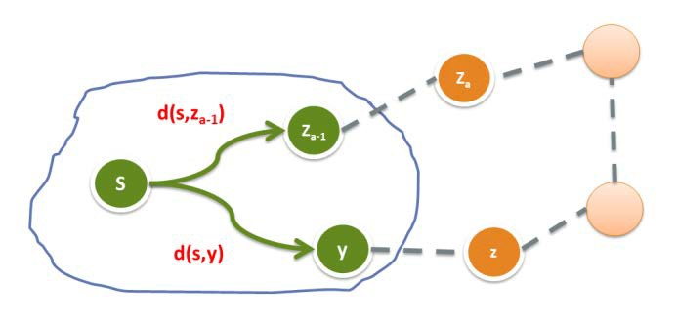

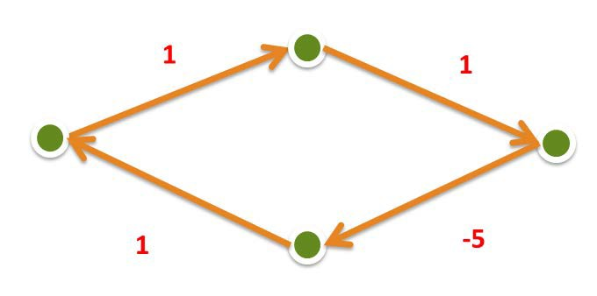
Negative Weight
Can the shortest path algorithm work correctly?
Dijkstra’s algorithm
No negative weight edge
Floyed’s algorithm
No negative weight cycle

Slide 27

Matrix Representation
Define family of matrix A^{(p)}:
o a_{ij} =true if and only if there is a path of length p from s_{i}
(p)
to s_{j}.
A⁽⁰⁾ is specified as identity matrix. A⁽¹⁾ is exactly the adjacency matrix.
Note that a_{ij}⁽²⁾=true if and only if exists some s_{k},
such that both a ⁽¹⁾ and a ⁽¹⁾ are true. So,
ik kj
ªij^{(2)=∨}k=1,2,…,n ^{(a}ik
⁽¹⁾∧a_{kj}⁽¹⁾), which is an entry in
the Boolean matrix product.

Slide 28


Boolean Matrix Operations
Boolean matrix product C=AB as:
^{o c}ij^{=∨}k=1,2,…,n^{(a}ik^{∧b}kj⁾
Boolean matrix sum D=A+B as:
o d_{ij}=a_{ij}∨b_{ij}
R, the transitive closure matrix of A, is the sum of all A^{p}, p is a non-negative integer.
For a digraph with n vertices, the length of the longest simple path is no larger than n-1.

Slide 29

Bit Matrix
A bit string of length n is a sequence of n bits occupying contiguous storage(word boundary) (usually, n is larger than the word length of a computer)
If A is a bit matrix of n×n, then A[i] denotes the ith row of A which is a bit string of length
n. a_{ij} is the jth bit of A[i].
The procedure bitwiseOR(a,b,n) compute a∨b bitwise for n bits, leaving the result in a.

Slide 30




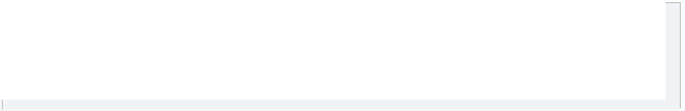

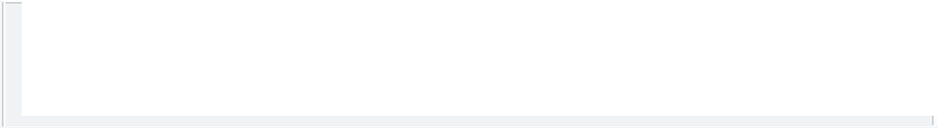

Straightforward Multiplication of Bit Matrix
Computing C=AB
o <Initialize C to the zero matrix>
o for (i=1; i≤n, i++)
Thought as a union of sets (row union), n² unions are done at most
o for (k=1; k≤n, k++)
o
if (a_{ik}==true) bitwiseOR(C[i], B[k], n)
Union for B[k] is repeated each time when the kth bit is true in a different row of A is encountered.
In the case of a_{ik} is true, c_{ij}=a_{ik}b_{kj} is true iff. b_{kj} is true. As a result: C[i]=∪_{k∈A[i]}B[k], (A[i]={k|a_{ik}=true)

Slide 31



Reducing the Duplicates by Grouping
Multiplication of A, B, two 12×12 matrices
A₁ 1 0 1 1 0 1 0 1 0 0 0 1
A₂ A₃ A₄ A₅
12 rows of B are divided evenly into 3 groups, with rows 1-4 in group 1, etc.
With each group, all possible unions of different rows are pre-computed.
1 0 1 1 1 0 0 1 1 0 1 1
A₆ | 0 1 0 1 | (This can be done with 11 unions if
A₇ | 1 0 1 1 1 0 0 1 1 1 1 0 | suitable order is assumed.)
A₈ A₉
^{A}10 ^{A}11 ^{A}12
When the first row of AB is computed, (B[1]∪B[3]∪B[4]) is used in stead of 3 different unions, and this combination is used in computing the 3rd and 7th rows as well.
Segment
Length t

Slide 32


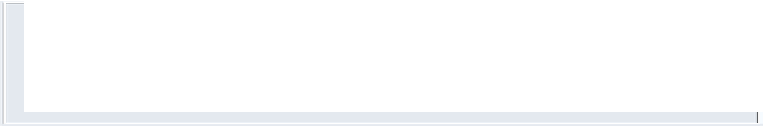
The Segmentation for Matrix A
The n×n array
1 2 … … t t+1 … … 2t … … (j-1)t+1 … jt …
A_{i} bitSeg(A[i],1,t)
bitSeg(A[i],2,t)
bitSeg(A[i],j,t)
Bit string of length t, looked as a t-bit integer

Slide 33




An Example
bitSeg(A[7], 1, t)
= 1011₂ = 11
Group 1 (1…t)
Group 2 (t+1…2t)
Group 3 (2t+1…3t)
_{A1} ⎡1 |  | 0 | 1 | 1 | 0 | 1 | 0 | 1 | 0 | 0 | 0 | 1⎤
⎢ _{A} 1 0 |  |  | 0 | 0 | 1 | 0 | 1 | 1 | 0 | 0 | 1 0⎥ ⎥ B₁ any union combination
_{A3} ⎢1 ⎢ |  | 0 | 1 | 1 | 1 | 0 | 0 | 1 | 1 | 0 | 1 | 1⎥ ⎥ | B₂ | of {B₁,B₂,B₃,B₄}, | Group 1
A₄ | ⎢0 | 1 | 1 | 0 | 0 | 0 | 1 | 0 | 1 | 0 | 1 | _{0⎥} B₃ totaling 16, 11 computed (1…t) B
A ⎢0 1 |  |  | 0 | 0 | 1 | 1 | 0 | 1 | 0 | 1 | 0 1⎥ _{B}⁴ ⎥ ⁵ any union combination
A₆ | ⎢1 | 1 | 0 | 1 | 0 | 1 | 0 | 1 | 1 | 0 | 1 | 0⎥ | ^{B6} of {B₅,B₆,B₇,B₈}, ^{Group 2}
A₇ ⎢1 0 ⎢ |  |  | 1 | 1 | 1 | 0 | 0 | 1 | 1 | 1 | 1 0^{⎥ B7} totaling 16, 11 computed ^{(t+1…2t)} ⎥ B₈
A₈ | ⎢1 | 1 | 1 | 1 | 0 | 0 | 1 | 1 | 0 | 1 | 1 | 0⎥ B₉
2
⎢
5
⎢
A₉ A
⎢₀
1 1 0 1 0 1 0 1 1 1
₀⎥
^{B}10 ^{B}11
any union combination of {B₉,B₁₀,B₁₁,B₁₂},
totaling 16, 11 computed
Group 3 (2t+1…3t)
⎢
⎥
10
⎢1 | 0 | 0 | 0 | 1 | 0 | 1 | 1 | 0 | 0 | 1 | 1⎥
⎢ ⎢0 | 1 | 0 | 1 | 0 | 1 | 0 | 1 | 0 | 1 | 0 | ₀⎥ ⎥
⎢⎣1 | 0 | 0 | 1 | 0 | 0 | 1 | 0 | 1 | 0 | 0 | 0⎥⎦
B
A
12
11
^{A}12
Lecturea on Algoritth=m4Design & Analysis (LADA), 2015
Where to store?
2015/5/19
33

Slide 34


Storage of the Row Combinations
Using one large 2-dimensional array
Goals
o keep all unions generated
o provide indexing for using
Coding within a group
One-to-one correspondence between a bit string of length t and one union for a subset of a set of t elements
Establishing indexing for union required
When constructing a row of AB, a segment can be notated as a integer. Use it as index.

Slide 35





Storage the Unions
one row for one group
column indexed by bitSeg(A[i],j,t)
⎡φ 4 3 3,4 2 2,4
8 7 7,8 6 6,8
12 10 10,12
2,3 2,3,4
1 1,4 1,3 1,3,4 1,2 1,2,4 1,2,3 1,2,3,4⎤
…… ⎥
⎥
⎦⎥
⎢_{φ}
⎢
⎢⎣φ
11 11,12
i,j,k stands for B_{i}∪B_{j}∪B_{k}

Slide 36




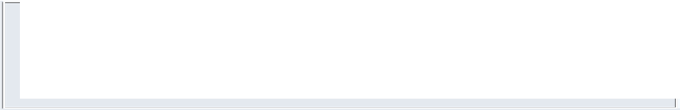

Array for Row Combinations
The array: allUnions
Containing in each row the union, of which the code is exactly i, looked as a t-bit binary number.
column i
row j
Indexed by segment coding for Matrix A
Containing all possible row combinations, totaling 2^{t}, within jth group of B
Lecturea on Algorithm Design & Analysis (LADA),
2015
36

Slide 37


Cost as Function of Group Size
Cost for the pre-computation
There are 2^{t} different combination of rows in one group, including an empty and t singleton. Note, in a suitable order, each combination can be made using only one union. So, the total number of union is g[2^{t}-(t+1)], where g=n/t is the number of group.
Cost for the generation of the product
In computing one of n rows of AB, at most one combination from each group is used. So, the total number of union is n(g-1)
37

Slide 38

Selecting Best Group Size
The total number of union done is:
g[2^{t}-(t+1)]+n(g-1) ≈ (n2^{t})/t+n²/t (Note: g=n/t )
Trying to minimize the number of union
Assuming that the first term is of higher order:
Then t≥lgn, and the least value is reached when t=lgn.
Assuming that the second term is of higher order:
Then t≤lgn, and the least value is reached when t=lgn.
So, when t≈lgn, the number of union is roughly 2n²/lgn, which is of lower order than n². We use
t=⎣lgn⎦
For symplicity, exact power for n is assumed

Slide 39

Sketch for the Procedure
t=⎣lgn⎦; g=⎡n/t⎤;
<Compute and store in allUnions unions of all combinations of rows of B>
for (i=1; i≤n; i++)
<Initialize C[i] to 0>
for (j=1; j≤g; j++)
C[i] = C[i] ∪ allUnions[j][bitSeg(A[i],j,t)]

Slide 40

Kronrod Algorithm
Input: A,B and n, where A and B are n×n bit matrices.
Output: C, the Boolean matrix product.
Procedure
o The processing order has been changed, from “row by row” to “group by group”, resulting the reduction of storage space for unions.

Slide 41


Complexity of the Kronrod Algorithm
For computing all unions within a group, 2^{t}- 1 union operations are done.
One union is bitwiseOR’ed to n row of C
So, altogether, (n/t)(2^{t}-1+n) row unions are done.
The cost of row union is ⎡n/w⎤ bitwise or operations, where w is word size of bitwise or instruction dependent constant.

Slide 42



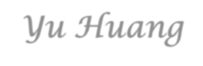
Thank you!
Q & A
Yu Huang
http://cs.nju.edu.cn/yuhuang

